Slide 1

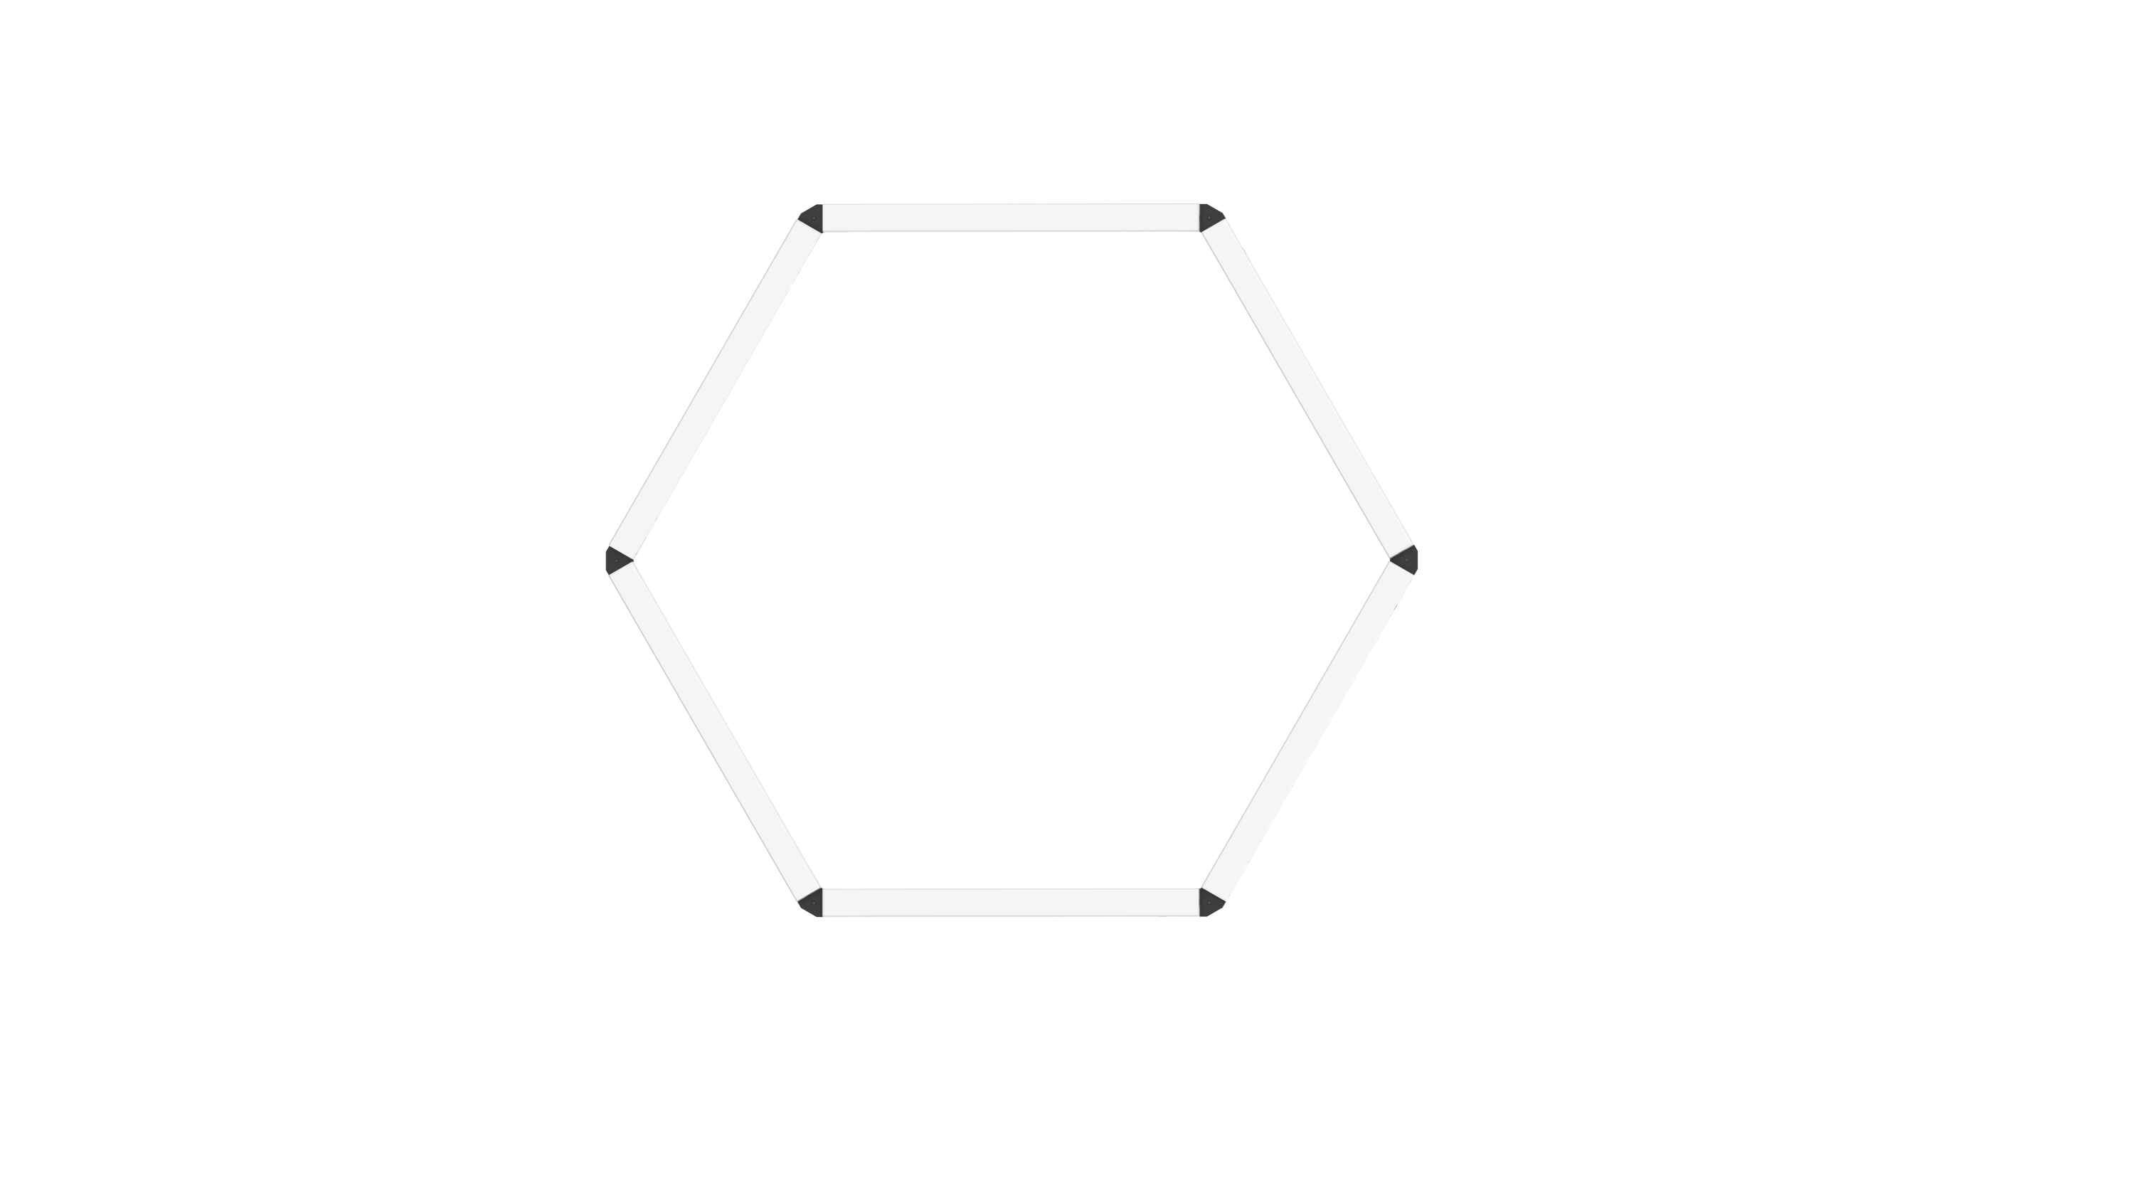
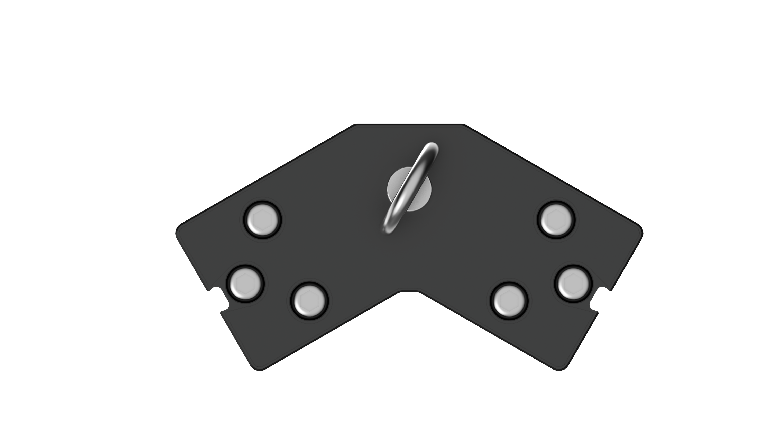
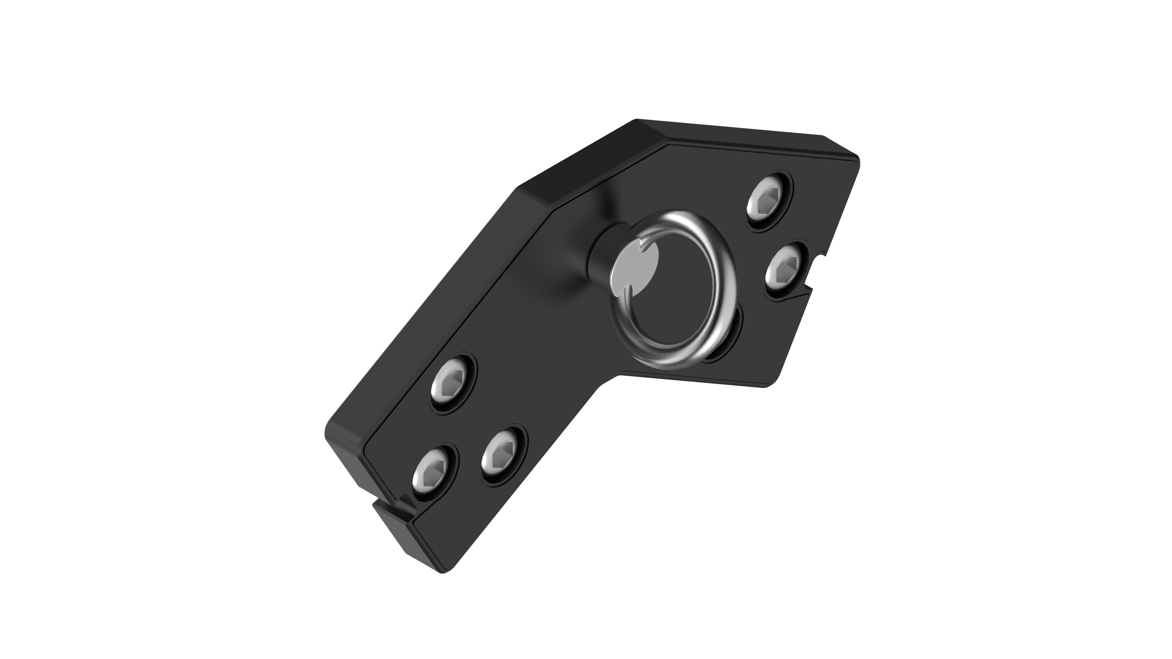
Product Description
INFINIBAR Hexagon Flat Connector Data Sheet
The INFINIBAR Hexagon Flat Connector is an all-metal mounting accessory that is designed to be used with any INFINIBAR (PB3/PB6/PB12) to create hexagonal or other uniquely angled lighting shapes.
Each connector features DC barrel connectors that allow the INFINIBARs to share power when being charged.
Each connector also features a ¼-20in screw thread for additional mounting with the included ¼-20in eye-bolts or other accessories.
Main Features
Connect Two INFINIBAR Lights onto a 120º flat Bracket
Use Six INFINIBAR Triangle Flat Connectors to build a Flat Hexagonal Lighting Fixture
Create Wrapping Lighting Fixtures
AC Power Passthrough for Both Connected Lights
Secure each INFINIBAR safely with Three Captive 5mm Hex Screws
All metal construction
Specifications
Weight | 128g / 0.28lbs
Target Audience
The INFINIBAR Hexagon Flat Connector is ideal for users who want to create flat hexagonal or other uniquely angled lighting shapes using an array of INFINIBARS.
What’s in the Box
Name | Qty
INFINIBAR Hexagon Flat Connector | 6
1/4-20in Eye Bolt | 6
5mm Hex Wrench | 1
Sales & Shipping Information
Product Name | INFINIBAR Hexagon Flat Connector
SKU | APD0300A33
UPC | 6971842186198
Packing Dimensions | 24.2 x 16.9 x 9.1cm 9.5 x 6.7 x 3.6in
Net Weight | 852g / 1.88lbs
Gross Weight | 1.01kg / 2.22lbs
Carton Quantity | 14 pcs
Carton Dimensions | 50.0 x 38.5 x 37.5cm 19.7 x 15.2 x 14.8in
Carton Weight | 15.41kg / 2.21lbs

